Slide 1
.Net Maui Navigation With Shell

Slide 2
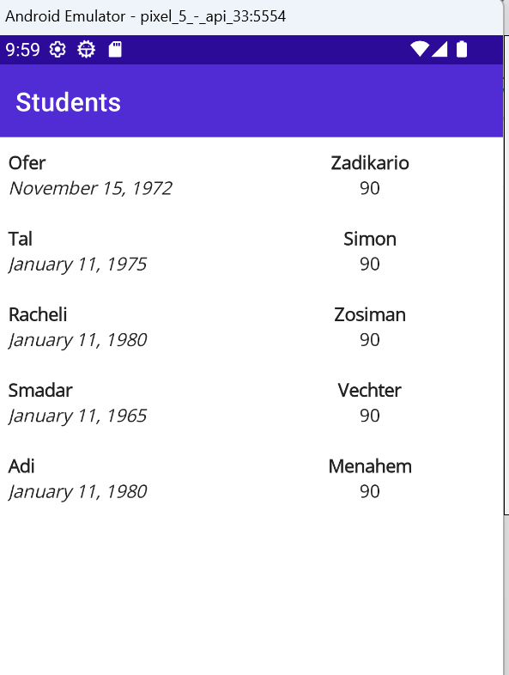
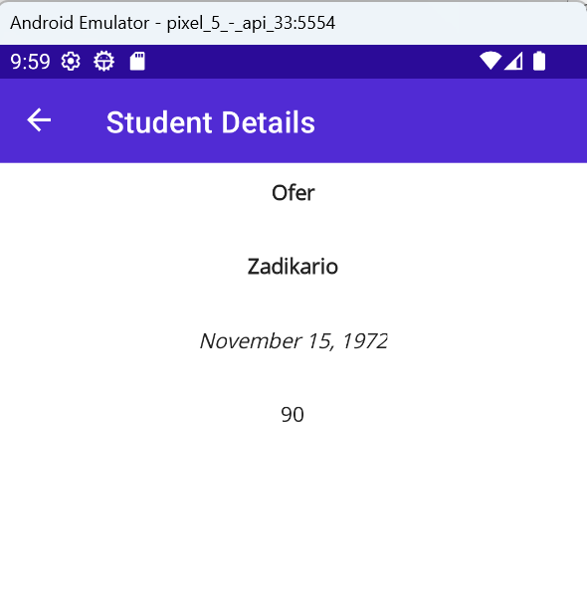
Navigation With Shell
Until now we developed a one page applications. At this chapter we will learn how to develop a multi page applications and how to navigate between the pages using Shell!

Slide 3
What is Shell?
Shell is a sub class of ContentPage!
Using Shell it is easy to define the story board of the app including:
Fly out Menu
Bottom and Upper Tabs
Navigation between pages using stack data structure
Shell Object is usually the Main Page of the App during the entire lifecycle of an app. It hosts all pages and load them as Data Templates views.

Slide 4
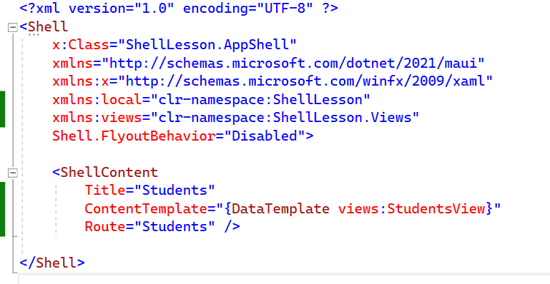
Shell Content Class
Shell Content object hosts a view, and display it under its title!
It also defines a “Route” – to be explained later
In the students example, The Shell object is initiated by the App and then the SHellContent object is built and load the StudentsView.

Slide 5
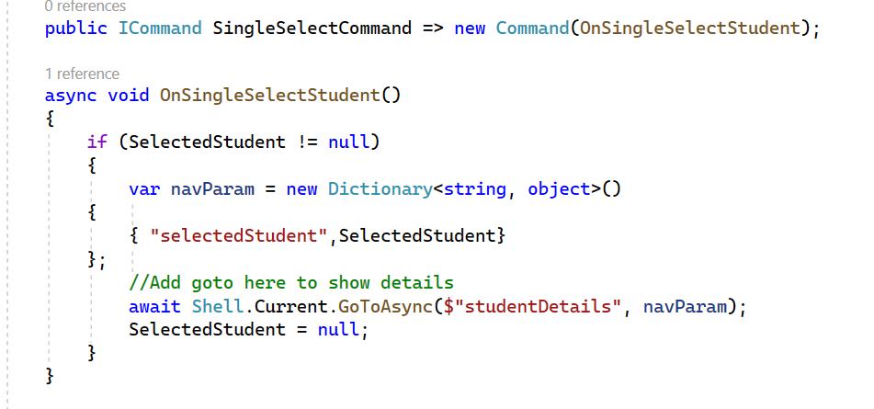
Navigating from one page to another
Shell.Current is a static variable holding a reference to the Shel object currently displayed
GotoAsync is a method that gets a route (like url to the page) and a dictionary of parameter name and value to be passed to the page!

Slide 6
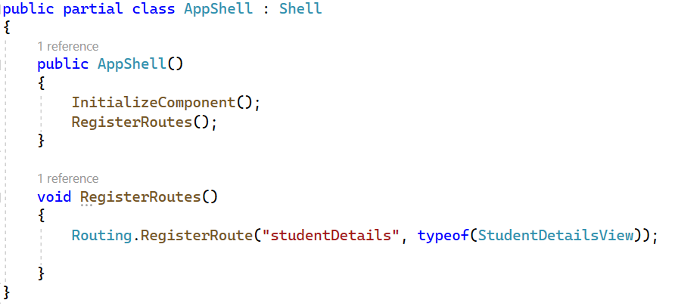
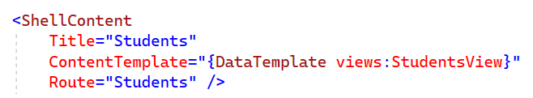
Defining a Route
A Route to a page is defined in the Shell Xaml or using code as follows.

Slide 7
Passing parameters to destination page
Parameters can be sent to the destination page in two ways.
Using a Dictionary<string, object>:
Using a “web like format” on the route it self:

Slide 8
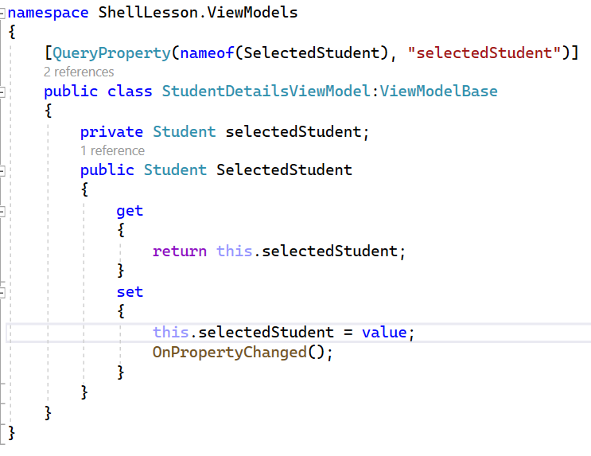
How the destination page gets the parameters
Parameters sent to the destination page are automatically copied to properties in the view model of the destination page based on the following definition:

Slide 9
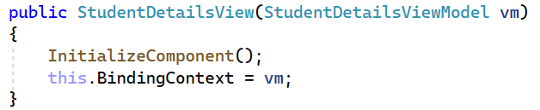
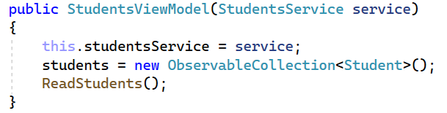
Using Dependency Injection
When using Shell, All page objects and View Model objects are created by the Shell itself!
It is very easy to use Dependency Injection in this case!
Note that all page constructors in the example gets the view model as parameter, ready to be used!
And the View Model get the Service class as parameter ready to be used!

Slide 10
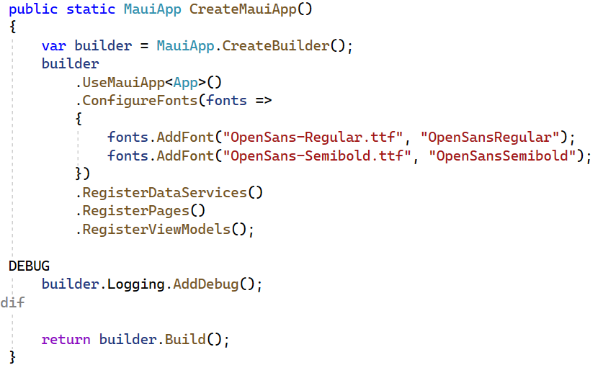
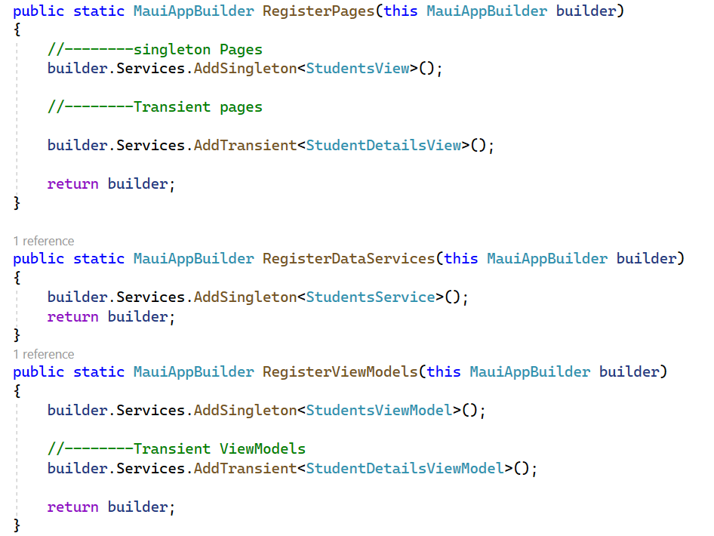
How to register classes to be injected
In order to register pages, viewmodels and services for injection, we are using the .Net Maui builder:
Note the difference between Transient and Singleton objects!

Slide 11
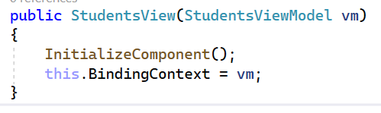
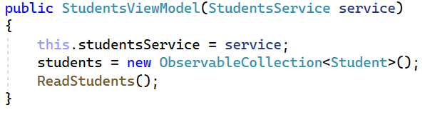
Quick Summary of how to work with Dependency Injection:
In the MauiProgram class – Register all Service, View Model and View classes using the Maui app builder:
When writing Page classes constructor, add the page view model as parameter. On the view model classes constructor add the service class as parameter if necessary:

Slide 12
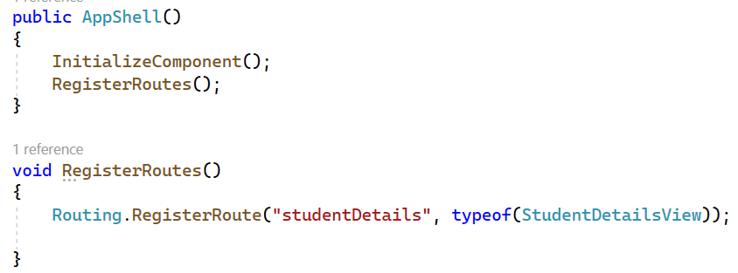
Quick Summary of how to work with Routes:
In the AppShell class constructor – Register all Routes!

Slide 13
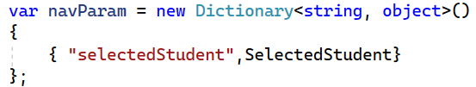
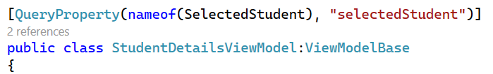
Quick Summary of how to open pages with Shell:
Use Shell.Current.GotoAsync method to open new pages.
If the new page works with input parameters:
Create A Dictionary<string, object> and insert into it all input parameters for the new page. Each parameter object should be named by a string.
On the new page view model, add a macro to connect every parameter to a property in the view model class.

Slide 14
Exercise
Build a multi page application that include two pages:
A page showing a location picker and a collection view of monkeys from that location (done in the previous exercise)
A page showing a specific monkey name, details, location and photo

